Slide 1
CROSS-BORDER TAXATION OF ESTATES
by: Mr. Paresh P. Shah
P.P. Shah & Associates
Chartered Accountants
Email: ppshahandassociates.com

Slide 2
Cross-Border Taxation of Estates – Overview
Indian Property held by Foreigners / UK Residents
UK Property held by Foreigners / Indian Residents
Indian Property held by Foreigners / US Residents
US Property held by Foreigners / Indian Residents
Tools of Tax efficiency
Inheritance Tax Treaties

Slide 3
Connecting Factors - UK
UK Residents
UK Residents & Domiciled
UK Resident & Non-Domiciled
Ordinarily Resident or Not Ordinarily Resident – not relevant from April 6, 2013

Slide 4
UK New Statutory Residence Test
(after April 5, 2013)
Step | Residency Test | Residency Status
1 | If you have spent 183 days in the UK in that tax year (first UK test) | Resident
2 | If any one of the following 3 automatic overseas tests are met: You were resident in the UK for 1 or more of the 3 tax years preceding the tax year, and you spend fewer than 16 days in the UK in the tax year; You were resident in the UK for none of the 3 tax years preceding the tax year, and you spend fewer than 46 days in the UK in the tax year You work full-time overseas over the tax year, without any significant breaks during the tax year from overseas work, and: you spend fewer than 91 days in the UK in the tax year the number of days in the tax year on which you work for more than 3 hours in the UK is less than 31 | Non-Resident

Slide 5
UK New Statutory Residence Test
(after April 5, 2013)
 | Residency Test | Residency Status
Step 3 | If any one of the second and third UK tests are met: Second Test: You will meet this test if there is at least 1 period of 91 consecutive days, at least 30 days of which fall in the tax year, when: You have a home in the UK in which you spend a sufficient amount of time, and either you: have no overseas home, or have an overseas home or homes in each of which you spend no more than a permitted amount of time Third Test: You work full-time in the UK for any period of 365 days, with no significant break from UK work and: all or part of that 365-day period falls within the tax year more than 75% of the total number of days in the 365-day period when you do more than 3 hours of work are days when you do more than 3 hours of work in the UK at least 1 day which is both in the 365-day period and in the tax year is a day on which you do more than 3 hours of work in the UK | Resident

Slide 6
UK New Statutory Residence Test
(after April 5, 2013)
 | Residency Test | Residency Status
Step 4 | Sufficiency ties test: If you do not meet any of the automatic overseas tests or any of the automatic UK tests, you should use the sufficient ties test to determine your UK residence status for a tax year. You will need to consider your connections to the UK, called ties, and determine whether your ties, taken together with the number of days (as specified) you spend in the UK, are sufficient for you to be considered UK resident for tax purposes for a particular tax year. The four ties are: a family tie an accommodation tie a work tie, and a 90-day tie | Resident else Non-Resident

Slide 7
Domicile Status
Your domicile status is decided under general law, which means it must be interpreted according to previous rulings of the courts. There are many things which affect your domicile. Some of the main points are:
you cannot be without a domicile
you can only have one domicile at a time
you are normally regarded as domiciled in the country where you have your permanent home
your existing domicile will continue until you acquire a new one
your domicile is distinct from your nationality, citizenship and your residence status, although these can have an impact on your domicile
There are three types of domicile:
domicile of origin (normally that of the father or in case of unwed parents, of mother)
domicile of choice (settling in another country after attaining legal capacity to acquire new domicile at age of 16)
domicile of dependence (domicile of the person on whom you are legally dependant)

Slide 8
UK Taxability based on Tax Status
Status | Income Tax |  | Capital Gains Tax |  | Inheritance Tax
 | UK income | Foreign income | UK assets | Foreign assets | UK assets | Foreign assets
UK Resident and UK domiciled | Taxable | Taxable | Taxable | Taxable | Taxable | Taxable
UK Resident but not UK domiciled | Taxable | Remittance basis | Taxable | Remittance basis | Taxable | Exempt

Slide 9
UK Taxability based on Tax Status (con’t)
Status | Income Tax |  | Capital Gains Tax |  | Inheritance Tax
 | UK income | Foreign income | UK assets | Foreign assets | UK assets | Foreign assets
UK Non-Resident | Taxable | Exempt | Exempt except assets used in UK trade | Exempt | Taxable | Exempt
Non-Resident Trust i.e. (i) All the Trustees are non-resident, or (ii) Some of the Trustees are non-resident and the Settlor was non-UK domiciled and non-resident when Trust was set up | Taxable (based on different types of Trusts) | Exempt | Exempt except assets used in UK trade | Exempt | Taxable | Exempt as Excluded Property Settlement
Settlor – non-UK domiciled |  |  |  |  | Taxable | Exempt
Settlor – UK domiciled |  |  |  |  | Taxable | Taxable

Slide 10
UK Taxability based on Tax Status (con’t)
REMITTANCE BASIS:
If a UK-Resident but non-domiciled is not remitting overseas income & gains, he may opt for ‘Remittance’ basis of taxation by paying (i) GBP 30,000 if he has lived in UK for 7 out of past 10 yrs; (ii) GBP 50,000 if he has lived in UK for 12 out of past 14 years
DEEMED DOMICILE:
If he is domiciled in UK within previous 3 years or he is tax resident in UK in 17 out of 20 years preceding the death / gift.

Slide 11
Settlement on Trusts: UK Anti-Avoidance Rules
Inheritance Tax:
UK discretionary Trust: The transfer to a UK discretionary trust would usually be a chargeable lifetime transfer and the trust itself would be subject to the inheritance tax regime for discretionary trusts. As such there would be a 10 year anniversary charge and an exit charge on the distribution of assets from the trust.
Tax on Settlor on transfer as gift tax only if he does not survive 7 years
Every 10 years there would be tax on mark-to-market basis and tax on eventual distribution again on mark-to-market basis
However, if the settlor survives for 7 years from the date of the transfer, the assets transferred would usually be excluded from their estate for inheritance tax purposes. Thus 7 year survival is treated as no ‘misuse’

Slide 12
Settlement on Trusts: UK Anti-Avoidance Rules (con’t)
Inheritance Tax (con’t):
Assets in India / Offshore Trust: The inheritance tax implications would be similar to above. The transfer to the trust would be a chargeable lifetime transfer ('CLT') for inheritance tax purposes, and therefore a transfer of value above the remaining nil rate band i.e. upto GBP 325,000 or as revised from time to time, would be subject to a lifetime inheritance tax charge at 25%. If the trust was a non-resident trust, it would not be able to defer any capital gains on the transfer to the trust.
If the trust was an excluded property trust (settlor non-domiciled at the relevant time) it would be outside the scope of the UK inheritance tax discretionary trust regime. However in order for it to be an excluded property trust it would need to hold non UK assets and be established by a non UK domiciliary. If the Settlor is a UK domiciliary, the trust would be subject to the usual regime of 10 yearly anniversary charges and exit charges.
Thus, Indian situs assets could be considered for settlement to an Indian trust when UK resident / domiciled was a non-domiciled of UK

Slide 13
Settlement on Trusts: UK Anti-Avoidance Rules (con’t)
Income & Capital Gains Tax:
Income & Gains of an offshore trust would be attributed to UK resident settlors if defined people are actual or potential beneficiaries or receive a benefit.
The term "defined person" included the settlor/their spouse, their children and their children’s spouses and their grandchildren and their grandchildren’s spouses.
This is a very wide anti avoidance rule and means that an offshore trust could only be used to shelter gains if the spouse, children and grandchildren (and their respective spouses) were all totally excluded from benefiting from the trust. If they weren't, then the settlor would be taxed on the gains of the trust during their lifetime.
However, the above anti-avoidance rule is not yet applicable to a non-dom. This means that a non-dom could use an offshore trust to hold assets and benefit from the capital gains tax exemption in the trust. Effectively the trust could be a capital gains tax shelter for all non domiciliaries.
Thus, in case of UK domiciled person, such off-shore trust would be taxed as if no transfer is made by the settlor

Slide 14
UK Inheritance Tax Treaties
Executor might be able to reclaim tax through a double-taxation treaty if Inheritance Tax is charged on the same assets by the UK and the country where the deceased was domiciled at time of death
The relief will be limited to the actual amount of overseas tax paid on those assets.
UK has such treaties with France, Italy, India, Pakistan, Ireland, South Africa, Sweden, Switzerland, Netherlands and USA
Unilateral Relief:
If a transfer is liable to UK Inheritance Tax and also to a similar tax imposed by another country with which the UK does not have an agreement, the estate may be able to get relief under Unilateral Relief provisions.
For this purpose, UK law determines the location of the asset. If the tax that is charged on the asset by the other country exceeds Inheritance Tax on that asset, it limits the credit to the amount of Inheritance Tax.

Slide 15
U.S. Taxability based on Tax Status
Status of Transferor | Income Tax |  | Gift & Estate Tax
 | U.S. income | Foreign income | U.S. assets | Foreign assets
U.S. Persons - Individuals (US citizen, regardless of residence and US residence, regardless of citizenship) - Domestic corporations - US Trusts | Taxable | Taxable | Taxable if US domiciled | Taxable if US domiciled
Non-U.S. Persons - Neither U.S. Citizens nor U.S. Residents (i.e. Non-Resident Aliens) | Taxable | Exempt | Taxable (U.S. situs assets) | Exempt

Slide 16
U.S. Taxability (con’t)
U.S. Situs Assets for Estate Tax Purposes (examples):
U.S. situs real property, including houses and condominiums.
U.S. situs tangible personal property, such as jewelry, antiques, artworks and cars, unless the items are in transit or on loan for an exhibition.
Shares of stock of U.S. corporations, including shares of a U.S. co-operative corporation representing a co-op apartment. Shares of non-U.S. corporations are not U.S. situs property. The location of the certificate is immaterial. Mutual funds (including money market funds) organized in corporate form are U.S. situs property if incorporated in the United States.
If the fund is structured as a partnership or grantor trust, the situs of the fund depends on the situs of the underlying assets of the fund.

Slide 17
U.S. Taxability (con’t)
U.S. Situs Assets for Estate Tax Purposes (examples):
Cash deposits with U.S. brokers, money market accounts with U.S. mutual funds
Cash in U.S. safe deposit boxes as U.S. situs assets
Debts of U.S. obligors. However, publicly traded bonds qualify as “portfolio debt” and therefore are not subject to U.S. estate taxation.
Interests in limited or general partnerships that either do business in the U.S. or own assets in the U.S. will probably be considered U.S. situs assets.
However, Bank accounts maintained with U.S. banks are NOT U.S. situs property: this includes checking and savings accounts, time deposits and certificates of deposit.

Slide 18
U.S. Taxability (con’t)
Estates of Non-Resident Aliens are subject to U.S. estate tax only on U.S. situs assets.
The tax is assessed at the same rates as for U.S. citizens, but with only a $60,000 exemption (as opposed to the exemption of $5,340,000 (2014) for a U.S. person)
The unlimited marital deduction is available; however, if the surviving spouse is not a U.S. citizen, only property left to a Qualified Domestic Trust (QDT) will qualify. Various requirements are specified for a QDT to qualify important ones being that the trust must have at least one US trustee and principal distributions to the surviving spouse will be subject to estate tax
Thus (a) Indian Grantor Trust with Indian situs assets with U.S. persons being beneficiaries will not be taxed if settlor is a non-U.S. person
(b) Indian Grantor Trust with U.S. settlor and U.S. persons being beneficiaries is taxable in the hands of the settlor and in India also
(c) Indian non-Grantor Trust with U.S. settlor and with U.S. persons being beneficiaries is taxable both in U.S. and in India

Slide 19
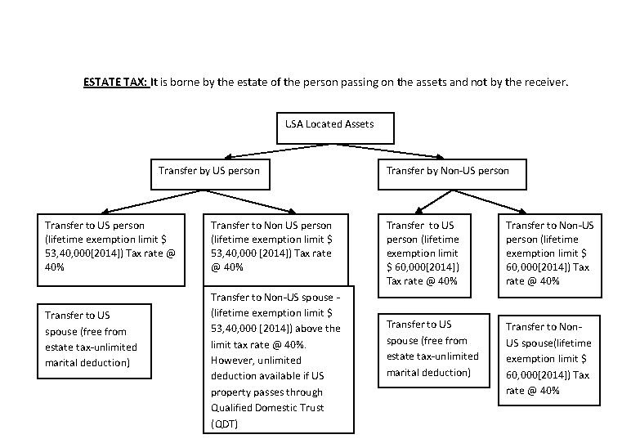
U.S. Estate Duty

Slide 20
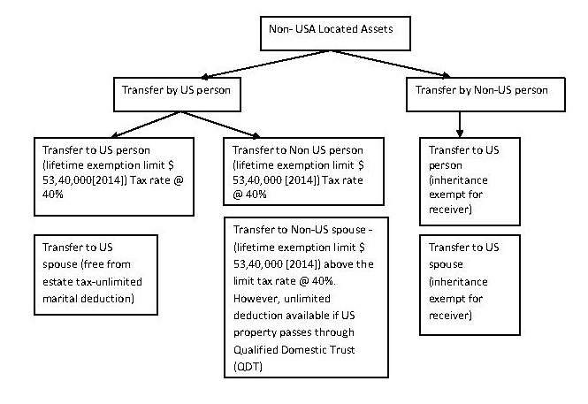
U.S. Estate Duty (con’t)

Slide 21
Grantor Trust: US Tax implications
A foreign (non-U.S.) trust is not subject to U.S. income tax. except for withholding tax on any U.S. source income. However, distributions from the foreign trust to a U.S. person (a U.S. citizen or a U.S. resident) will carry out distributable net income to that person, with adverse tax treatment of accumulated income, unless the trust qualifies as a “Grantor Trust" under U.S. law.
If trust qualifies as Grantor Trust, the U.S. beneficiary pays no tax on the income distributed to him from the trust (although he must
report the income to the IRS).
Therefore, a U.S. beneficiary of a foreign trust will greatly prefer
that the trust be a Grantor Trust with a non-U.S. person as grantor.

Slide 22
Grantor Trust: US Tax implications
A non-U.S. person will be treated as the grantor of a trust only
if one of the following requirements is met:
  If the Grantor has the full power to revoke the trust without the
  consent of any person, or with the consent of a subservient third party
  If the Grantor (and, if desired, the Grantor's spouse) are the sole
  beneficiaries of the trust during the life of the Grantor
Once the non-U.S. grantor dies, the offshore trust which previously qualified us a grantor trust under one of the exceptions is no longer a grantor trust, and all income distributed to the U.S. beneficiary will be taxed to him or her.

Slide 23
US Estate Tax Treaties
Treaties with individual countries may alter some of the rules, particularly as to determination of residence, source of income, situs of assets and income withholding rates.
The U.S. generally enters into treaties with countries that have significant taxes of their own, to help avoid double taxation.
Therefore, if a treaty allows a NRA to reduce his U.S. tax liability, there will usually be an offsetting tax in the NRA’s country of residence.
At present the United States has estate tax treaties with the following countries: Australia, Austria, Canada, Denmark, Finland, France, Germany, Greece, Ireland, Italy, Japan, Netherlands, Norway, South Africa, Sweden, Switzerland, United Kingdom
The U.S. also has separate gift tax treaties with Australia and Japan

Slide 24
Thank You

